Slide 1
Anaïs Luthereau
FOOD Systems
Let’s have a look at what people eat all over the world?
Activity 4

Slide 2
INTRODUCTION: A few questions to start
Why do you eat food?
Who is involved in preparing food at your home?
Do you participate in the kitchen around meal times? What do you do?
Who decides what to buy and what to eat?

Slide 3
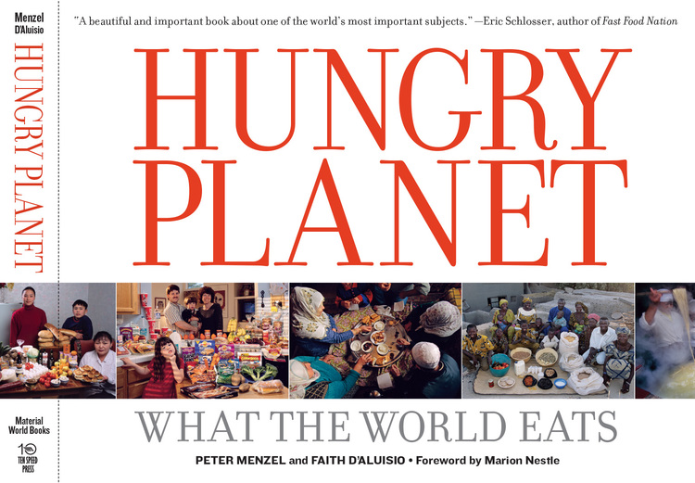
ACTIVITY 1:
“Hungry Planet: What the World Eats” by Peter Menzel and Faith d’Aluisio
https://www.menzelphoto.com/portfolio/G0000s3jj73.5TSs/I0000b87TAkdAsk8

Slide 4
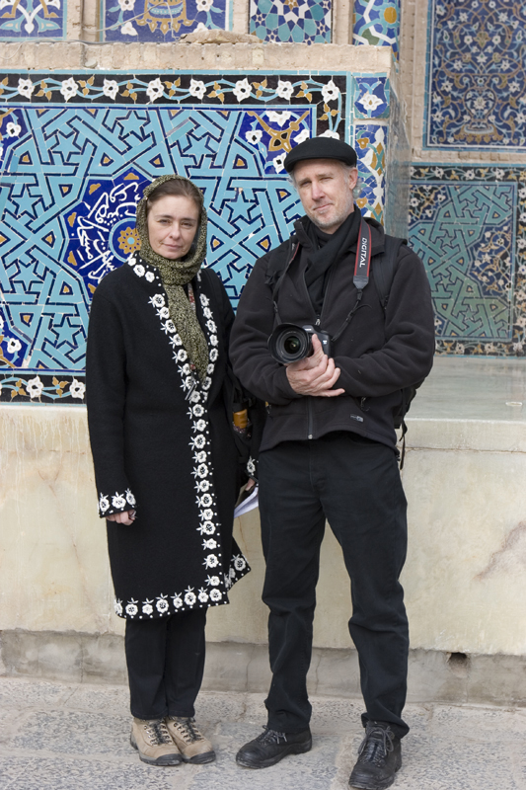
Hungry Planet photographer Peter Menzel with author and food stylist Faith D’Aluisio in Yazd, Iran
Notes:
The food people eat and the ways in which they serve and celebrate this food reveal a great deal about their culture, the local environment, and their relations with other places. For example, one family’s kitchen cupboards may store American brand-name processed foods alongside foods that have been grown on local farms for centuries. This combination indicates a crossroads between old and new, local and global. In recent years, globalization of food production and consumption, rising levels of affluence, and immigration have had a significant impact on eating habits and food acquisition around the world.
The Hungry Planet team had dinner with 30 families in 24 countries with the intention of “explor[ing] humankind’s oldest social activity: eating.” They documented families farming, shopping, cooking, and sharing meals. At the end of each visit, they took a photograph of the family surrounded by a week’s worth of food.
This presentation introduces you to 12 of these families. As you look at the photographs, pay careful attention to the details. What food items do you recognize? What do you find unfamiliar? What surprises you? What are the differences and similarities between what you see in these photographs and what you’re used to in your own life? What do these families’ methods of acquiring and preparing food tell you about their overall lifestyles and cultures? What does their diet reveal about their level of affluence and health?

Slide 5
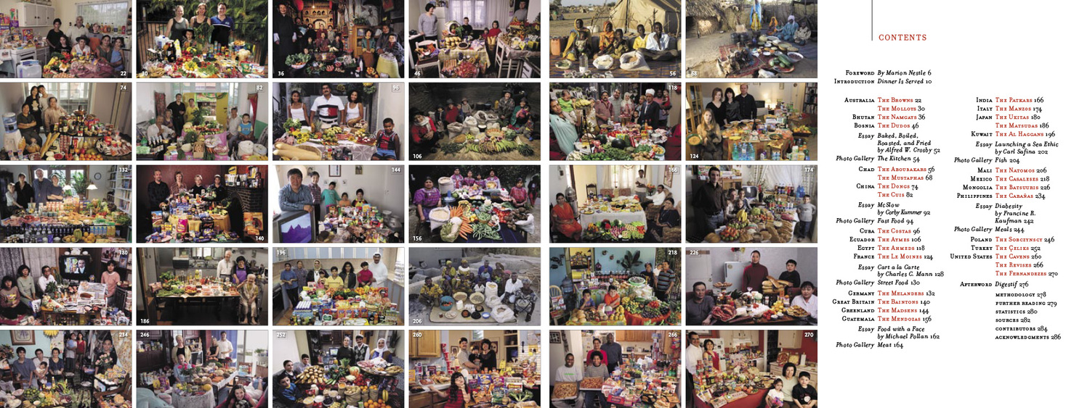

Slide 6
What does a family eat in one week around the world?
Observations
the amount of food the amount of packaging on foods the amount of whole/raw food vs processed foods the variety of foods the amount of people in the photo who have to share the food the amount of global foods the amount of local foods the amount of food from each food group
What can we observe?

Slide 7
Countries | Guatemala | Bhutan | USA | Japan | France | Chad
Amount of food
Amount of packaging on food
Amount of whole/raw food
Amount of processed food
Variety of foods
Number of people sharing the food
Amount of global foods
Amount of local foods
Quantity of Proteins
Quantity of Grains (cereals)
Quantity of Fruits and vegetables
Quantity of Junk food
Money spent/ week $1 = 0.96€ | $............. USD / week | $............. USD / week | $............. USD / week | $............. USD / week | $............. USD / week | $............. USD / week
Cooking methods available | Gas stove top/ wooden stove | Clay stove fuelled by wood fire | Electric stove, toaster oven, microwave, BBQ | Gas stove, rice cooker | Electric stove Microwave oven | Wood fire
Preservation methods available | refrigeration | Natural drying | Fridge and freezer | Small fridge and freezer | Fridge and freezer | Natural drying

Slide 8
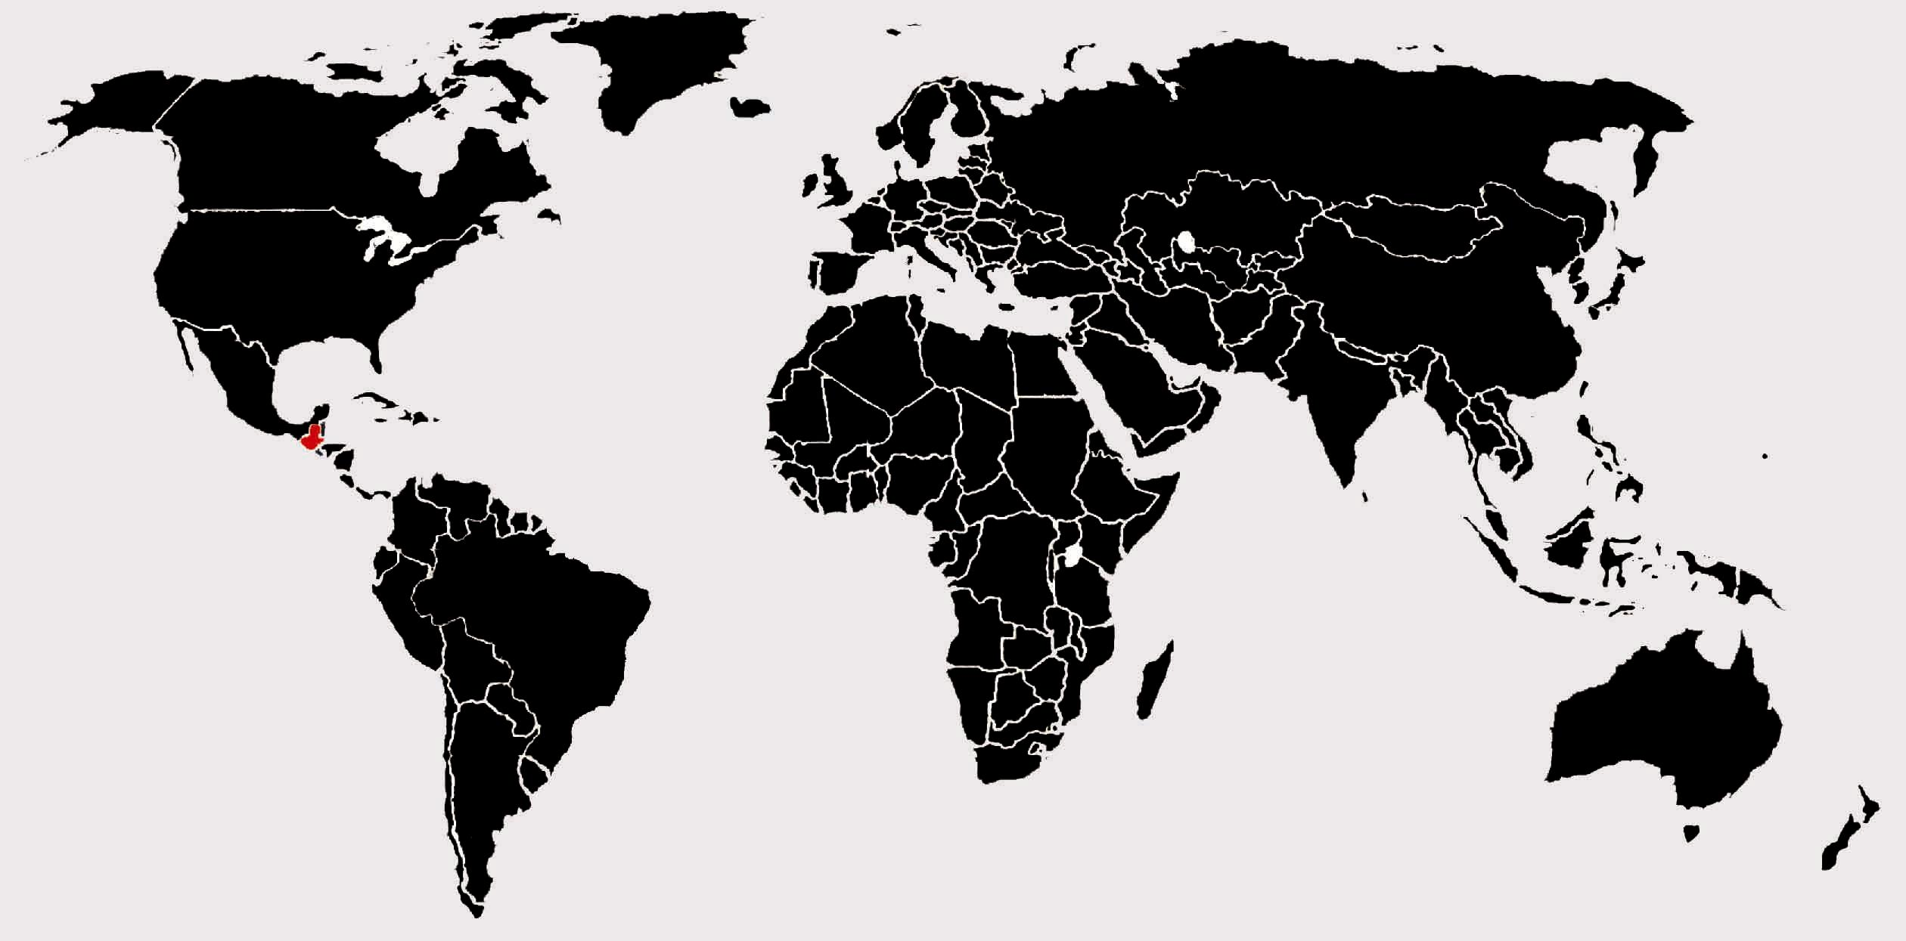
Guatemala
Large indigenous population
Mostly Catholic, some Protestant
All Saints Day festival
Notes:
About 66% of this Central American country’s population is indigenous, meaning that they descended from the Mayan people who lived here before Europeans arrived. The family you will meet in the following slides, the Mendozas, live in a Mayan town in the northwestern part of Guatemala. Despite their Mayan heritage, most people in this region are Catholic, with a significant Protestant minority. The Hungry Planet team visited the village of Todos Santos Cuchumatán (“All Saints”) during the important Christian festival of All Saints Day, which commemorates all the saints of the church.

Slide 9
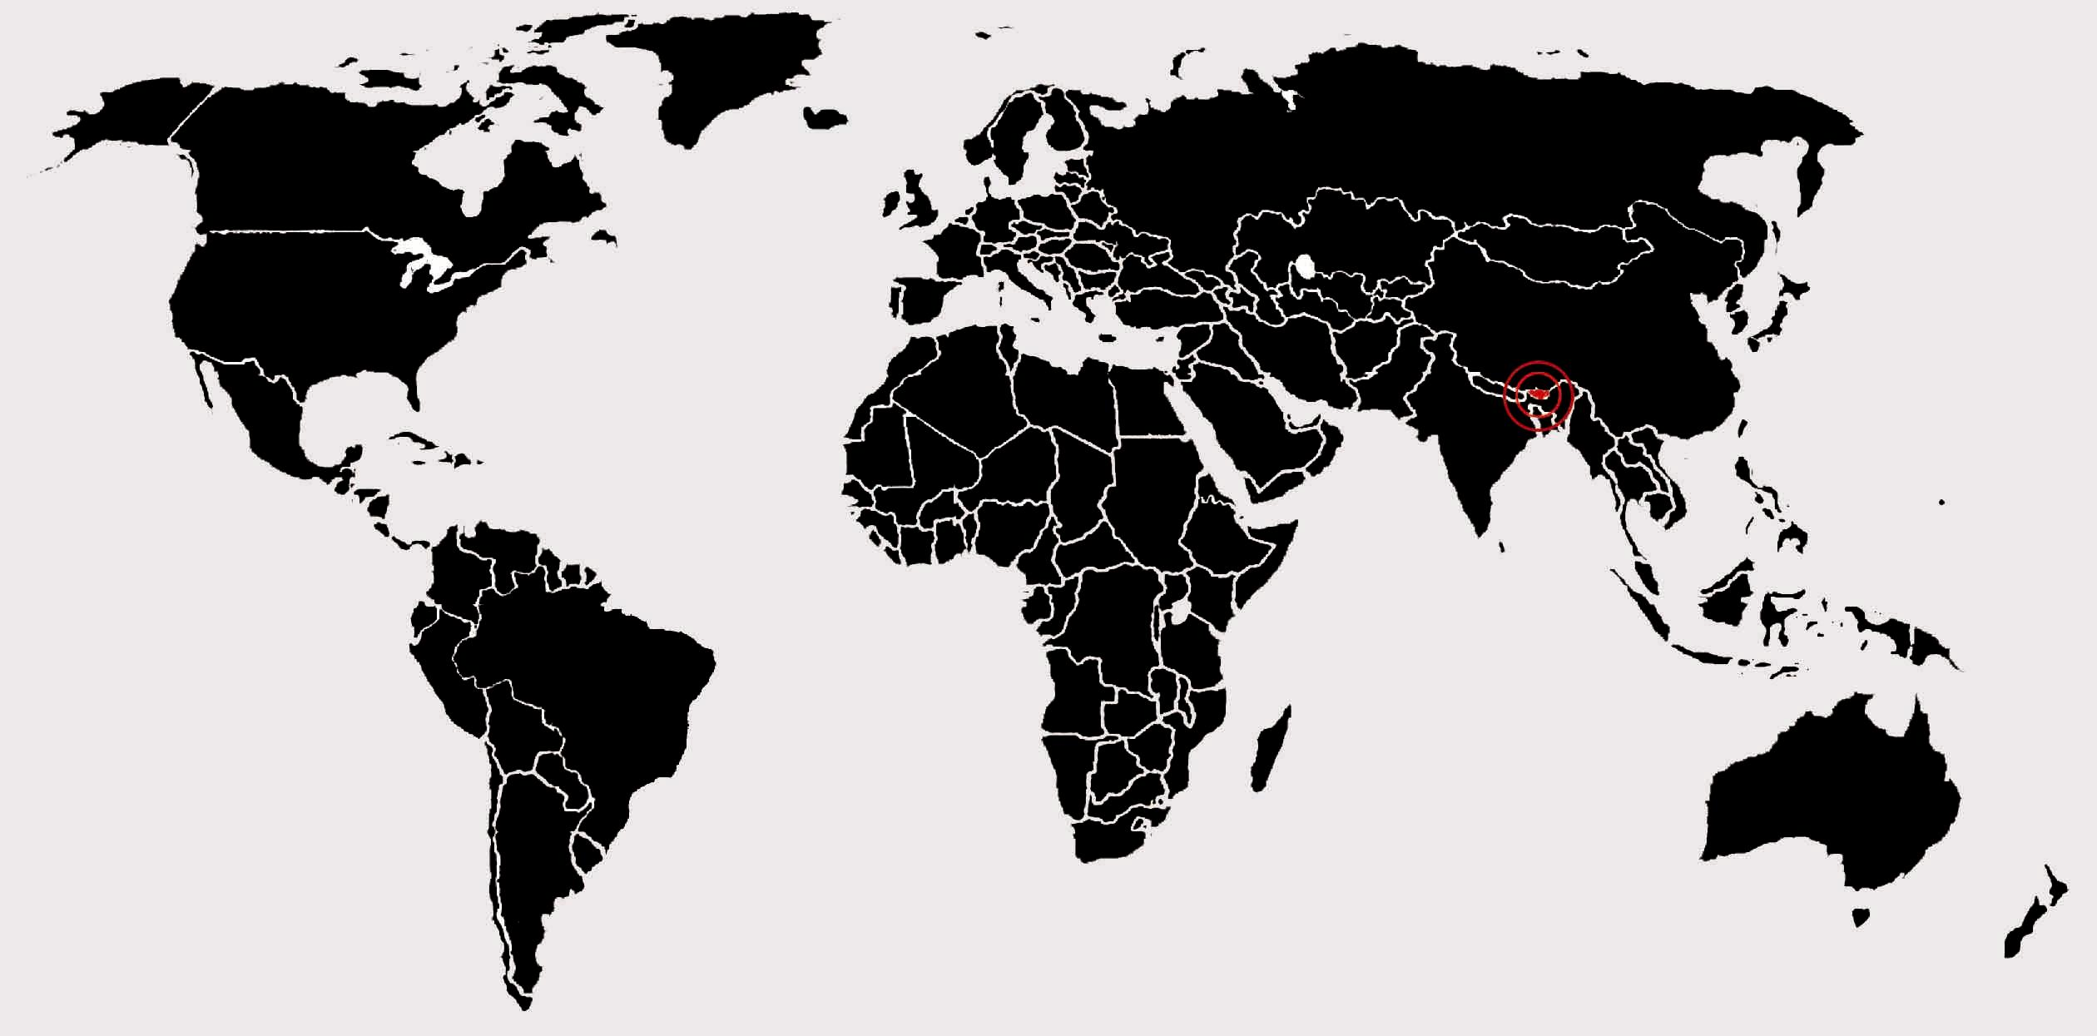
Bhutan
Subsistence farming
New electricity
Notes:
Most residents of this small mountainous country in the Himalayas practice subsistence agriculture. The Namgay family of Shingkhey Village is no exception. They grow most of their own fruits and vegetables and try to avoid having to purchase these items at the market. On the occasions when they do need to buy food at the market, they feel a financial pinch. In this way, they typify subsistence farmers around the world.
During the Hungry Planet team’s visit, Shingkhey Village was finally connected to Bhutan’s electrical grid. This electrification will likely bring change to the villagers’ lives, possibly affecting the ways in which they preserve and prepare food.
The next slides introduce you to the Namgays’ lifestyle, as seen through the family’s weekly food supply.

Slide 10
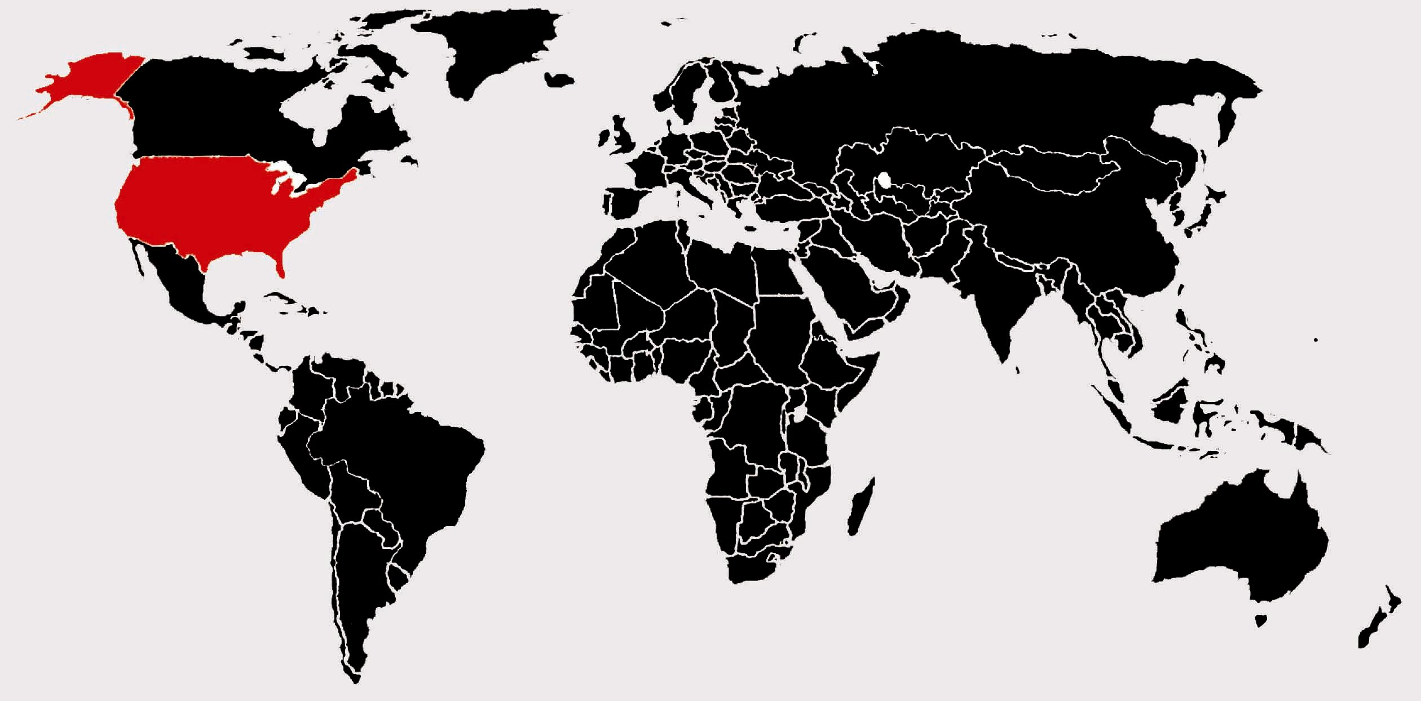
United States
Global trendsetter
“Junk food”
Many Americans trying to watch their diet
Notes:
In many ways, the United States sets global trends for food and beverage consumption. You have noticed familiar American brands in many of the previous photographs. These brands invariably include a good deal of “junk food,” such as soft drinks, potato chips, and candy. Many American families who have become highly accustomed to eating this type of food are now trying to find healthier alternatives. This is the case for the Revis family of North Carolina.

Slide 11
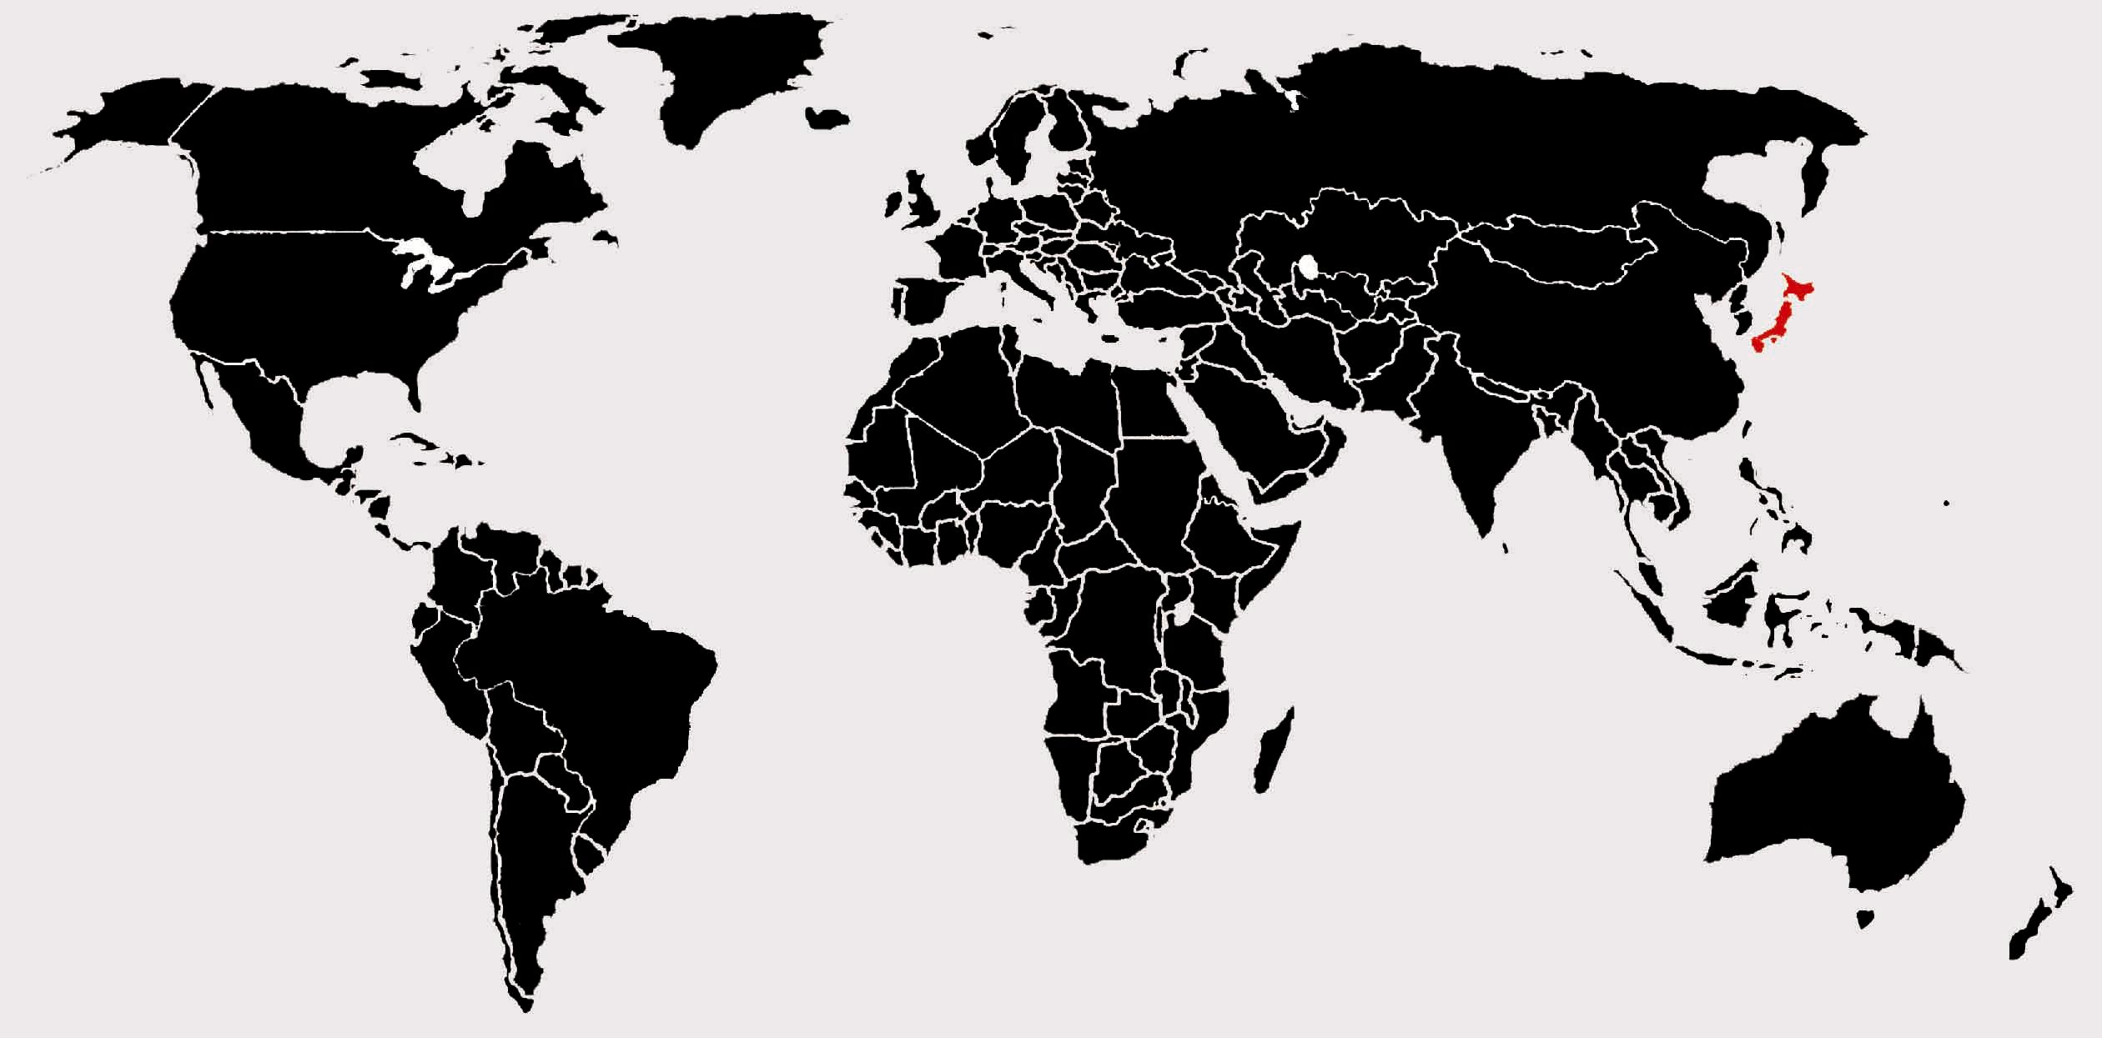
Japan
Island country
Relatively homogeneous
Notes:
The island country of Japan is home to unique culinary delights. Although some cultural differences exist between various parts of the country, Japan is a relatively homogeneous nation where culture and food remain relatively consistent throughout the regions. The Ukita family, featured on the next slides, lives near Tokyo in Kodaira City

Slide 12
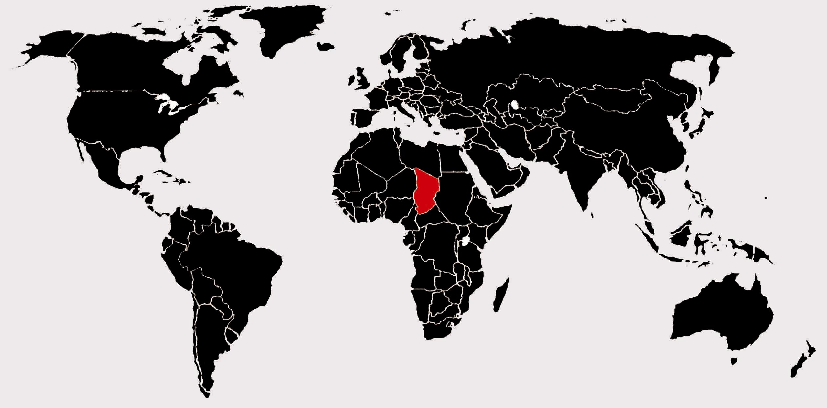
Chad
War in Sudan
Janjawiid killed thousands
Humanitarian crisis, with refugees fleeing into Chad
Notes:
The Darfur region of Sudan has witnessed a tremendous amount of tragedy and violence in recent years. In 2003, after decades of war, the Sudanese government joined Arab Muslims against non-Arab black African Muslims in a brutal conflict in this western section of Sudan. The pro-government Arab militia, called Janjawiid (“man with a horse and a gun” in Arabic), struck back against non-Arab rebel groups by plundering villages and killing thousands of people across the region. This devastation led to a refugee crisis, as thousands of Sudanese fled into neighboring Chad. These refugees have settled in sprawling camps such as Breidjing, where the Aboubakar family lives.

Slide 13
Let’s compare: similarities and differences?
What is interesting and/or surprising about the images?
Which family spend more money on food?
$1 = 0.96€
France: $419.95 USD / week
USA: $341.98 USD / week
Japan: $317.25 USD / week
Guatemala: $75.70 USD / week
Chad: $18.33 USD/ week
Buthan: $5.03 USD / week

Slide 14
Let’s compare: similarities and differences?
What is interesting and/or surprising about the images?
Which family spend more money on food?
What factors influenced their food options?
home environment
cooking methods available
preservation methods available
factors:
amount of whole food vs processed food
local vs global food
homemade food

Slide 15
ACTIVITY 2: How does our Food system impact the Environment?
Many foods have a long and complicated journey before they make it to our plates which can affect the earth and the environment in many ways.
Where does your food come from?
How does it get to you? (process /travel / packaging?)
What happens to the food that is not eaten?

